Slide 1
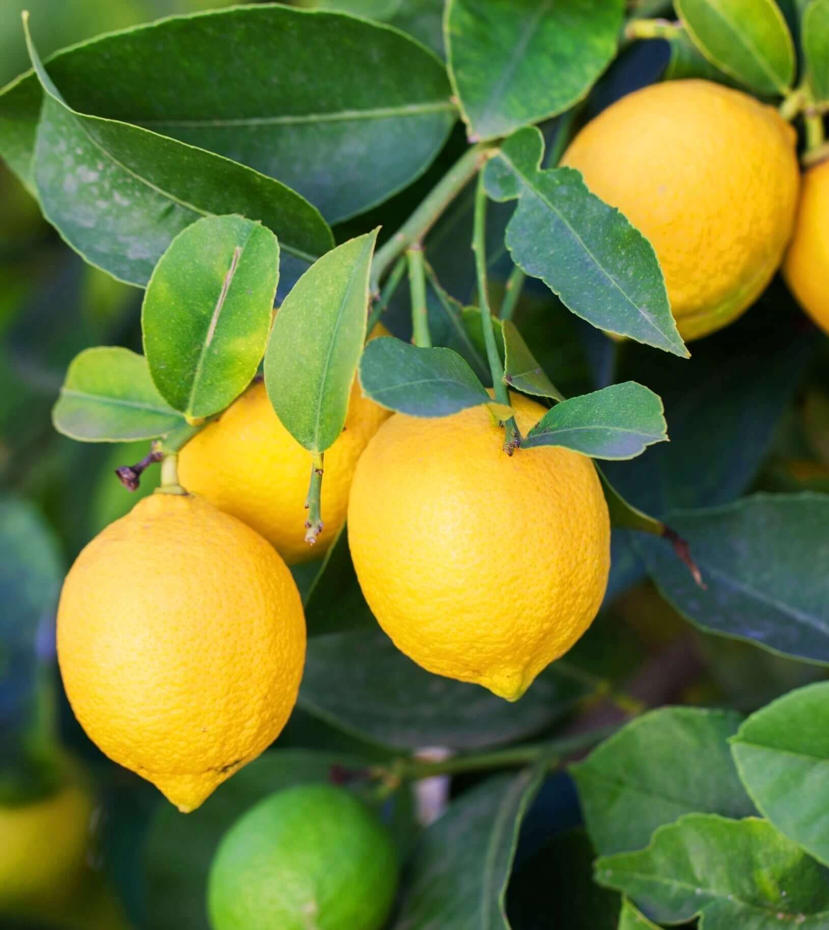
Lemon Health Monitoring
1
David Kotler
Maxim Cherepanov
Supervised by: Dr.Naomi Unkelos-Shpigel

Slide 2

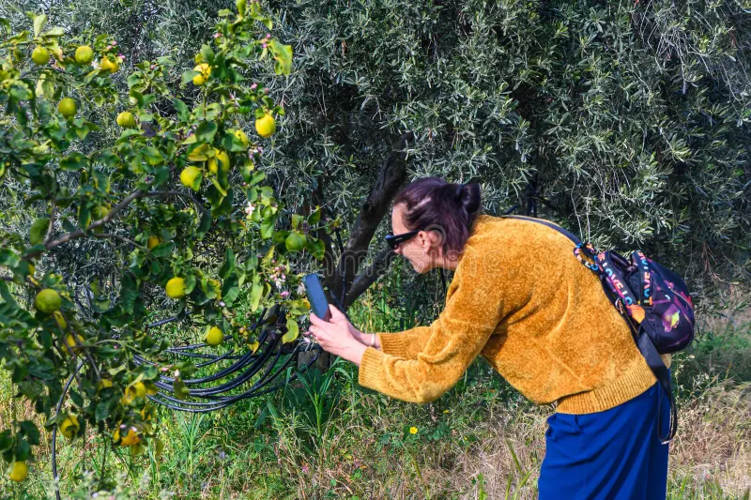

The problem
2
Detection and diagnosis of lemon diseases are performed manually by farm workers.
Cons:
Smart diseases detection and diagnosis platform
Time-consuming
Error prone
Our solution:
Inconsistent
Scalability issues
Fast
Accurate
Consistent

Slide 3
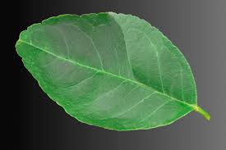
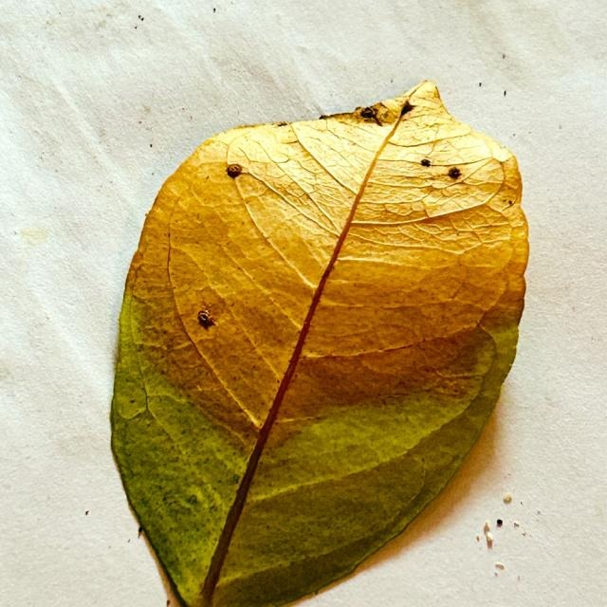
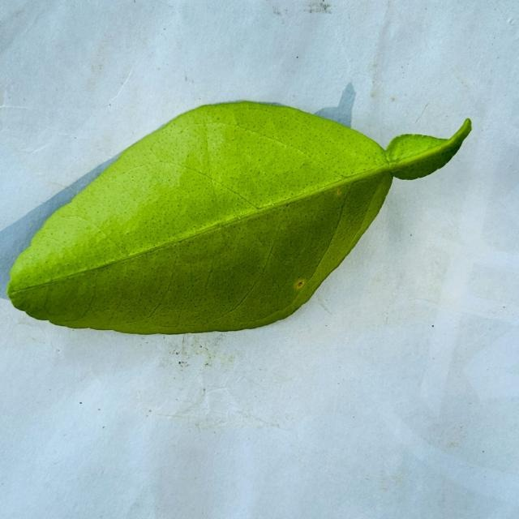
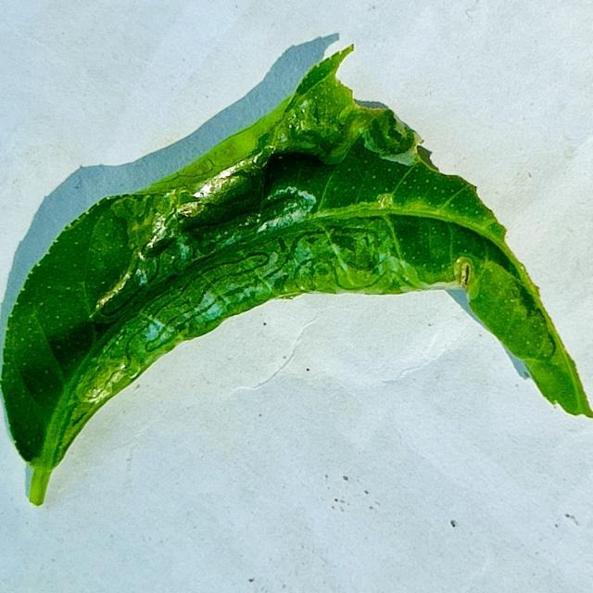
Lemon leaves diseases
3
Lemon crops suffer from various types of diseases.
Two of the main challenges affecting citrus plants, especially lemons, are dehydration and viral infections.
Healthy (hydrated) leaf
Dry leaf (dehydration)
Healthy leaf
Curl Virus
Both can be identified through their leaves !

Slide 4
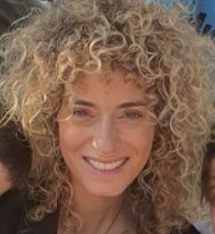
Collaboration
4
Keren Bensamhon Meshrki , Farm manager
Real-world partner : We worked with Keren, a manager of an agricultural farm in Israel, to understand real challenges in lemon cultivation.
Main points:
Disease detection done manually.
Monitoring lemon orchards for early disease detection is challenging.
Lack of real time alerts and analysis data.

Slide 5




Workflow
5
Problem definition
Identify major lemon diseases and challenges in detection.
System design
Design system architecture and choose relevant technologies
Collaboration with farmers
Understand real-world needs, farming conditions, and common issues
Prototype development
Build prototype for testing and user feedback

Slide 6
Requirements
6
FR requirements
Get image data from smartphone cameras or IoT connected cameras | The system will allow the user to send smartphone pictures or collect them from cameras.
Run interval monitoring | The system will capture image data and run models without user input.
Save past results | The system will save past results from the pipeline.
Exposed API | The system will allow all its function to be run through an external API.

Slide 7
Requirements
7
NFR requirements
Model Performance | The pipeline including all models should finish running within 5 seconds.
Model Accuracy | The pipeline and models shall provide accuracy scores of at least 90%.
Interface Usability | The user web interface should be accessible and intuitive.
Interface Responsiveness | The interface shall run on both smartphones and computers

Slide 8
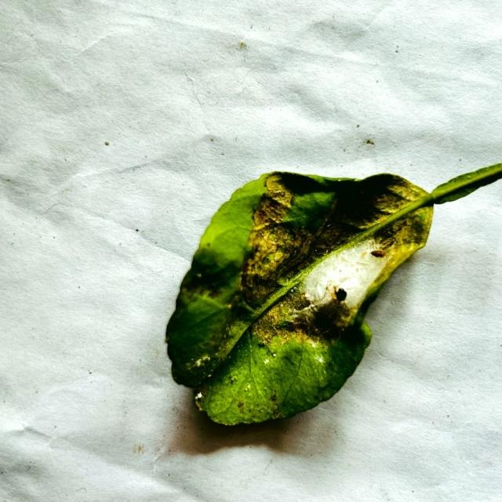
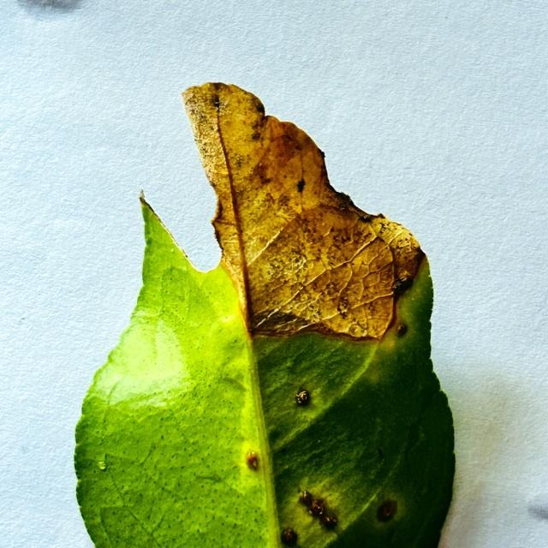
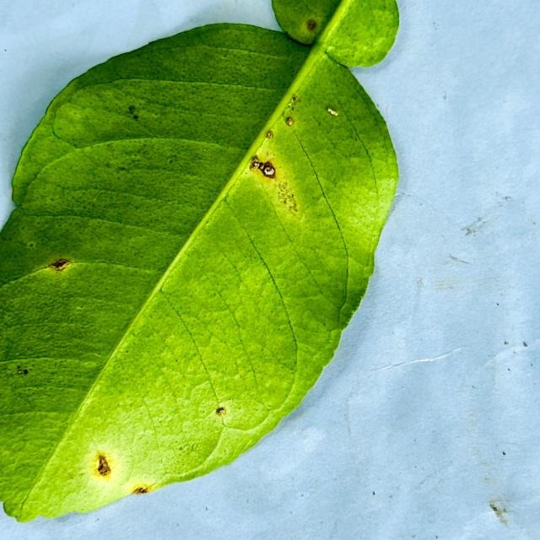
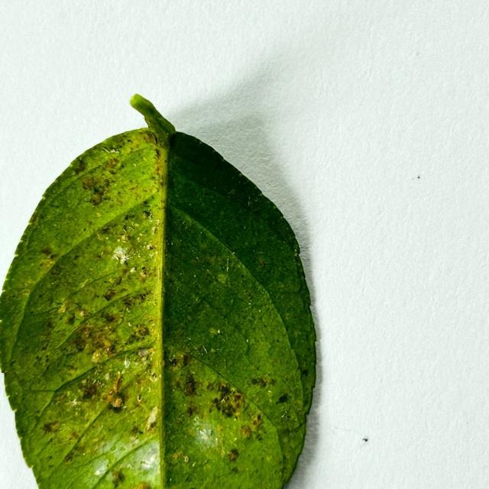
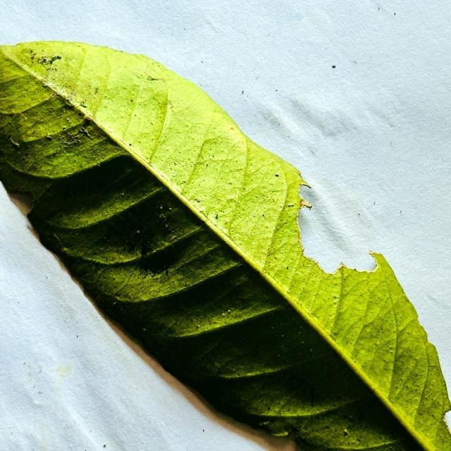
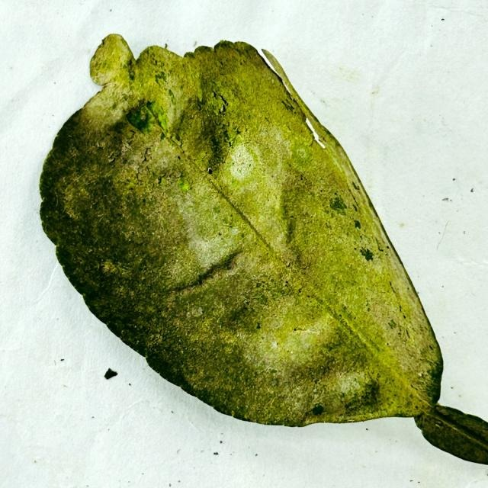
Data set
Anthracnose
8
Spider Mites
Citrus Canker
Anthracnose
Healthy leaf
Bacterial Blight
Deficiency diseases
Curl virus
Sooty Mold
Dry leaf

Slide 9
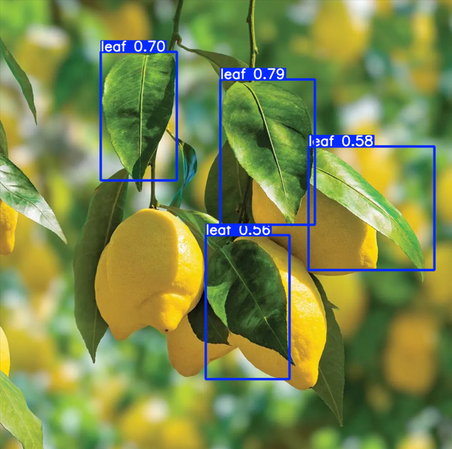
Our Algorithm
9
The system is built using two main models:
YOLOv11 computer vision model - fast and efficient object detection model, to identify and isolate lemon leaves.
Identifying the leaves
EfficientNetV2 - is a family of convolutional neural networks that offering fast and efficient image classification tasks.
Identifying the disease

Slide 10
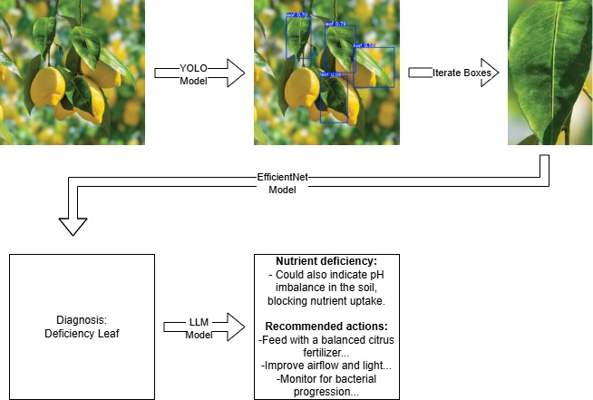
Algorithm workflow
10

Slide 11
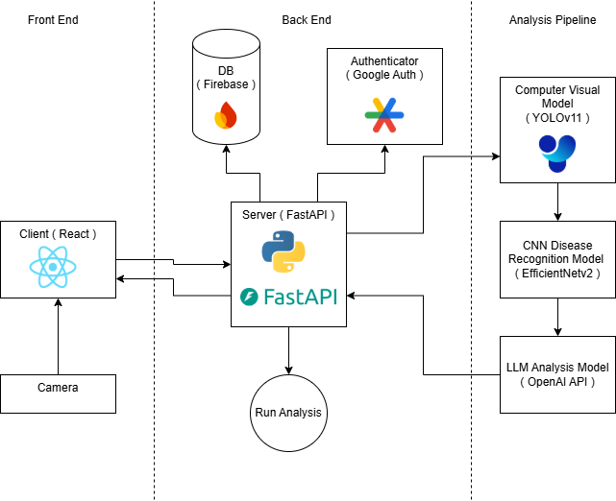
System architecture
11

Slide 12
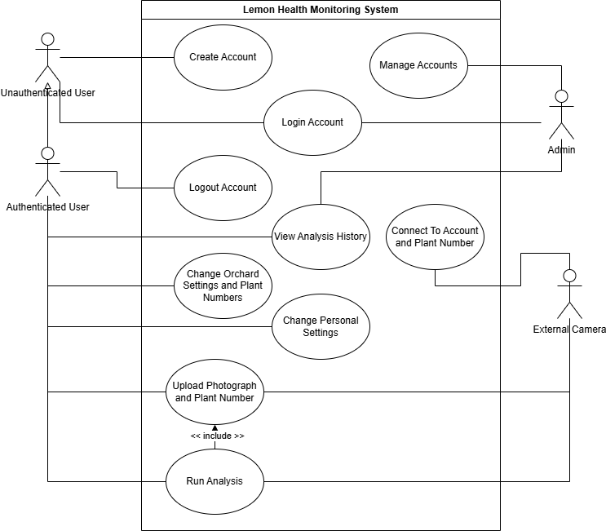
Use case diagram
12

Slide 13
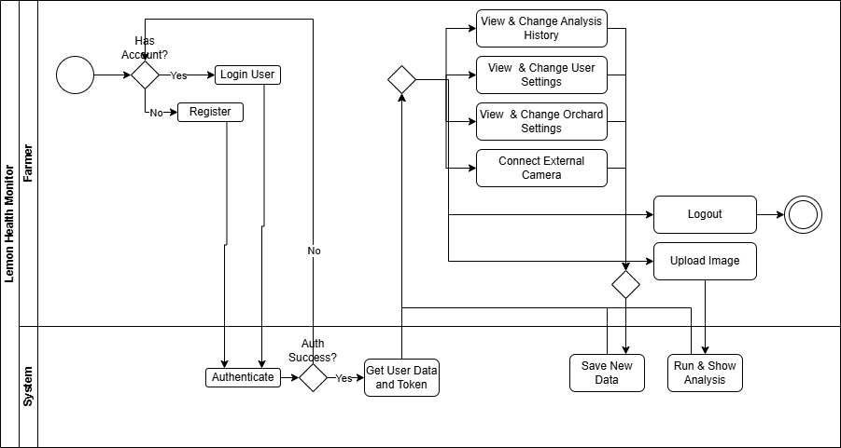
Activity diagram
13

Slide 14


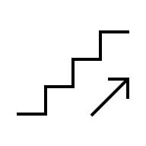
Challenges & Expected achievements
14
Challenges:
Expected achievements:
Provide fast accurate results.
Accurate plant analysis - As a main goal for the project we expect to provide accurate (>90%) analysis of the lemon plant
Performative plant analysis - We aim to Deliver results in under 5 seconds per image.
Modular and scalable system - Both in the sense that the system should be able to support 100 + concurrent users
User centric system – we aim to achieve SUS usability score ≥ 80 and mobile and desktop accessibility
Get good results on lower quality images.
Design scalable system capable of supporting multiple users.

Slide 15
Testing
15
Testing Approach
Our testing approach will combine both technical validation of the machine learning models and practical validation of the complete system.
Model testing
Backend API Testing
Frontend Testing
Each model in the pipeline will be evaluated on labeled datasets using standard performance metrics (accuracy, precision, recall, F1-score)
Unit and integration tests will verify that the FastAPI backend correctly handles image input, executes the analysis pipeline, and returns the correct results.
Usability and responsiveness of the web interface will be tested across devices

Slide 16
Thank you
16

